Slide 1
Edge Analytics & Logging Bootcamp
Analytics

Slide 2
Edge Analytics Services
Purpose: Understand API usage, see long-term API usage trends, and segment audiences.
Dashboards
Check API adoption rates
Developer Metrics
Evaluate performance of APIs used by apps; verify to conformance
Custom Reports
Evaluate bottom-line impact and ROI
Monitoring
Verify SLA conformance; plan capacity expansion

Slide 3
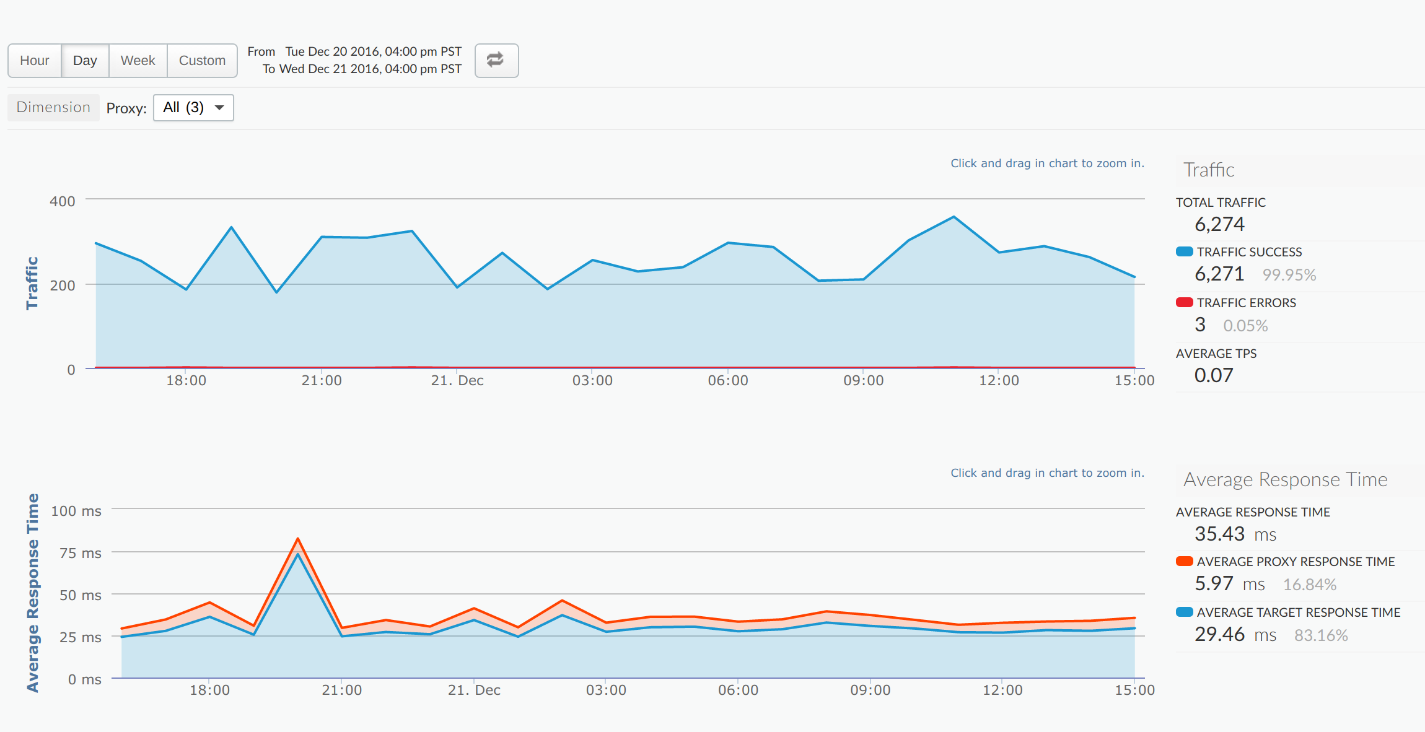
Edge Analytics Services
serves as the repository for analytics data
dashboards give information about all APIs or only specific APIs, and support drill-down to allow deeper analysis
provides statistical graphs that can be customized to meet specific requirements
allows statistics to be extracted using APIs and imported into other systems for further analysis

Slide 4
Edge Analytics Services
Analyze trends for your API program, inspect and diagnose problems, and generate reports.
Out of the box reports include:
API Proxy Performance - visualize how much traffic your APIs generate and how long it takes for API calls to be processed
Business Transactions - helps you understand changes in API traffic that might be caused by specific business, marketing, or partner events
Cache Performance - visualize the benefit of the cache in terms of lower latency and reduced load backend servers
Developer Engagement - tells you which of your registered app developers are generating the most API traffic
Devices - tells you about the devices and servers that are being used to access your APIs
Error Code Analysis - tells you about error rates for API proxies and targets.
Geomap - tracks traffic patterns, error patterns, and quality of service across geographical locations
Latency Analysis - can alert you to any latency issues your API proxies may be experiencing
Target Performance - helps you visualize traffic patterns and performance metrics for API proxy backend targets
Traffic Composition - measures the relative contribution of your top APIs, apps, developers, and products to your overall API program
Custom Reports - way to specify precisely what you want to measure across your API program

Slide 5
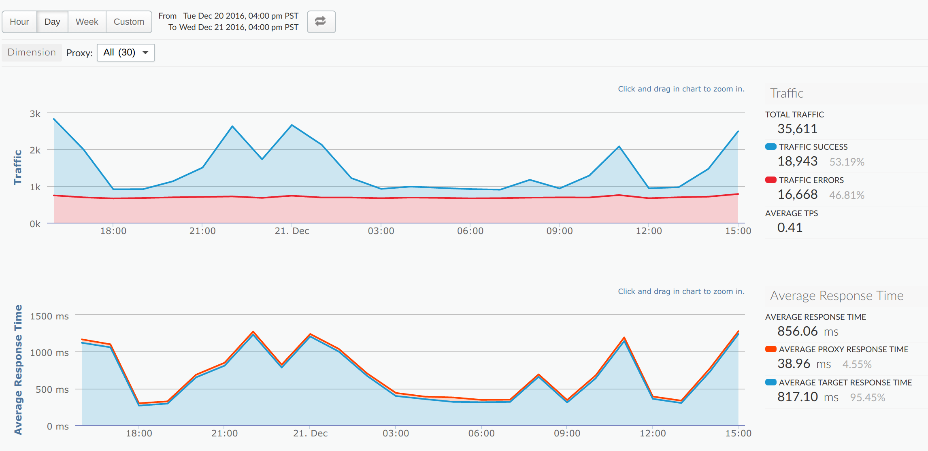
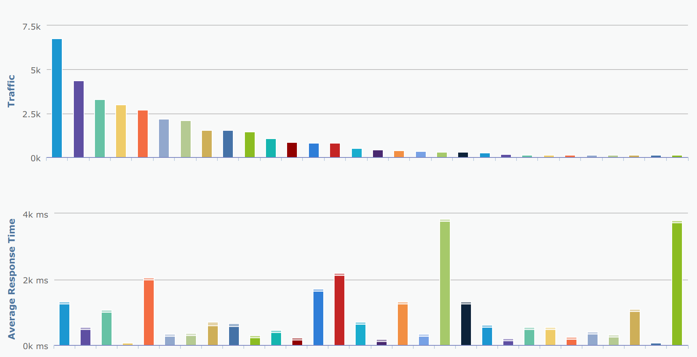
API Proxy Performance

Slide 6
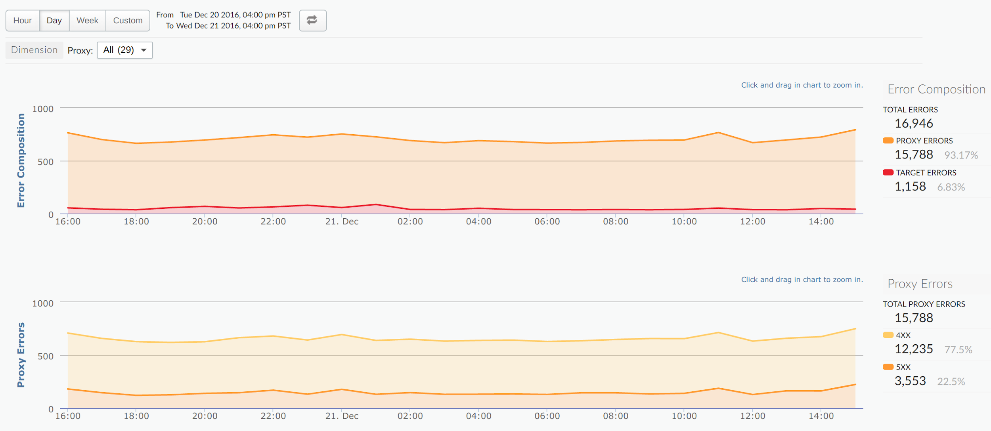
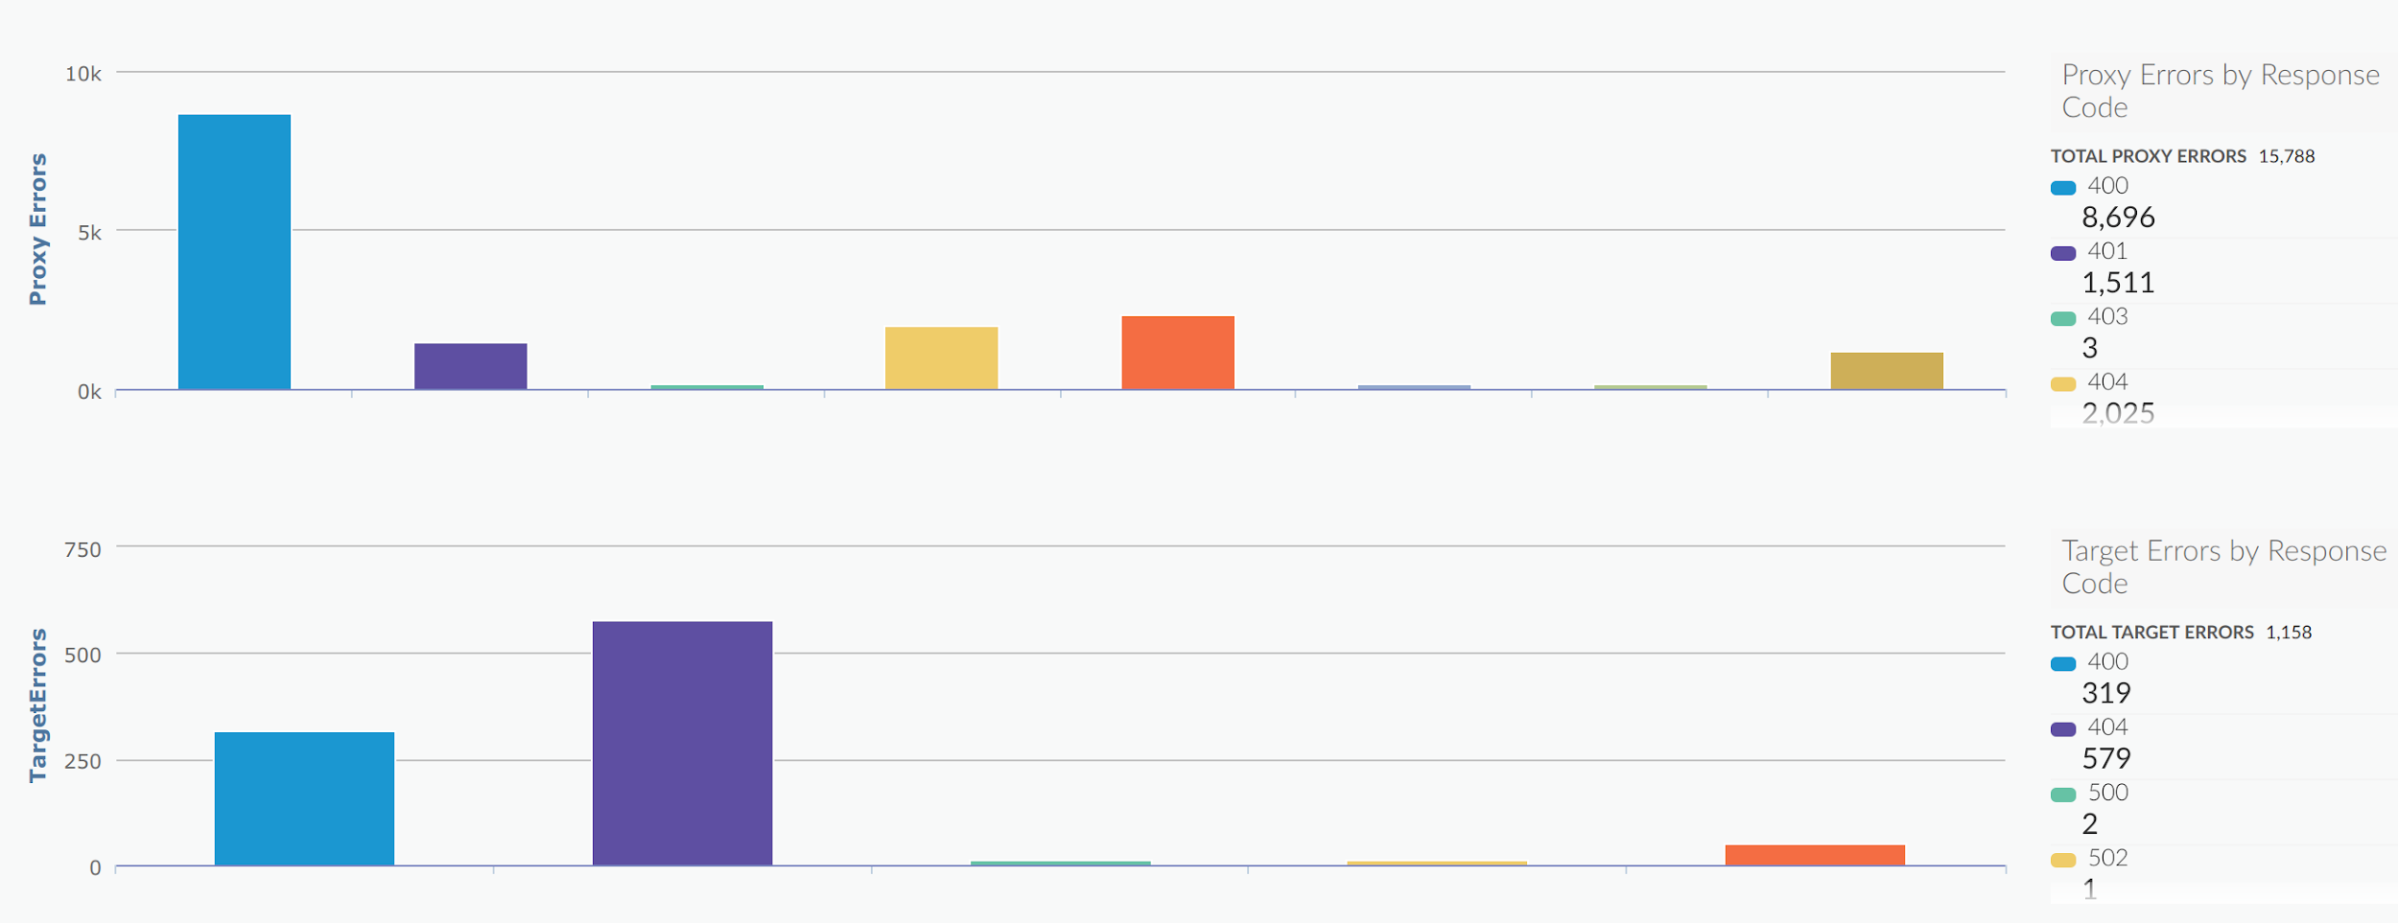
Error Code Analysis

Slide 7
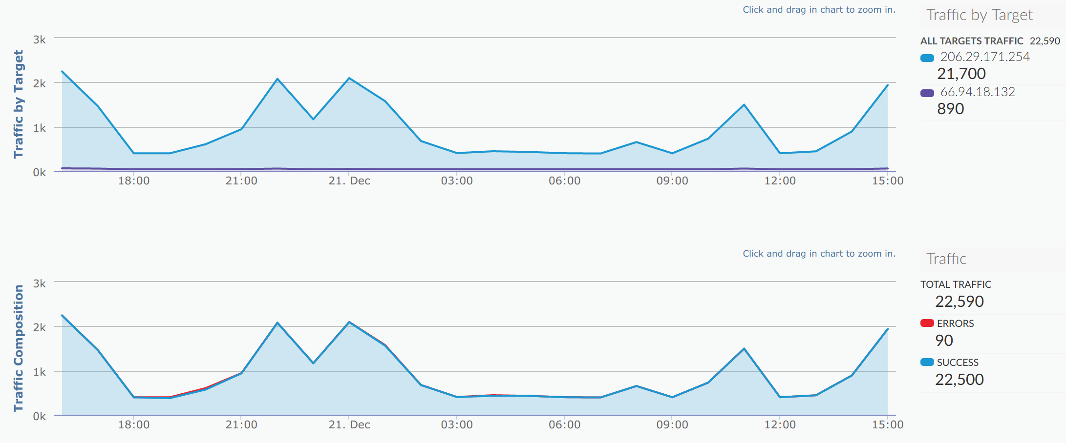
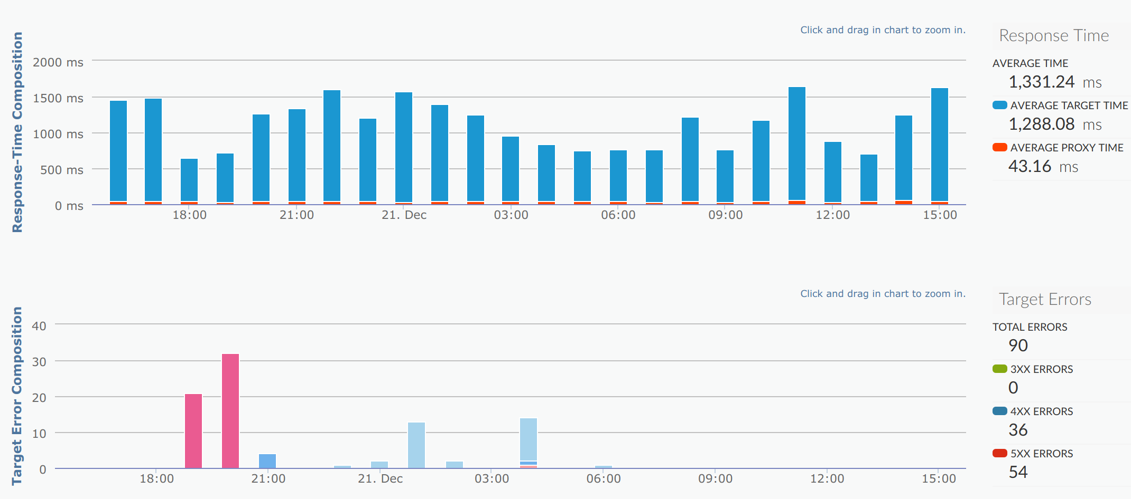
Target Performance

Slide 8
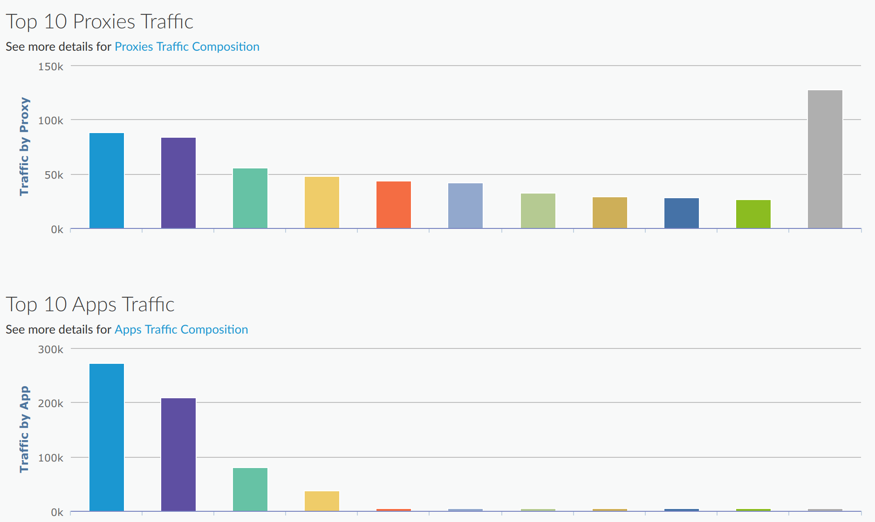
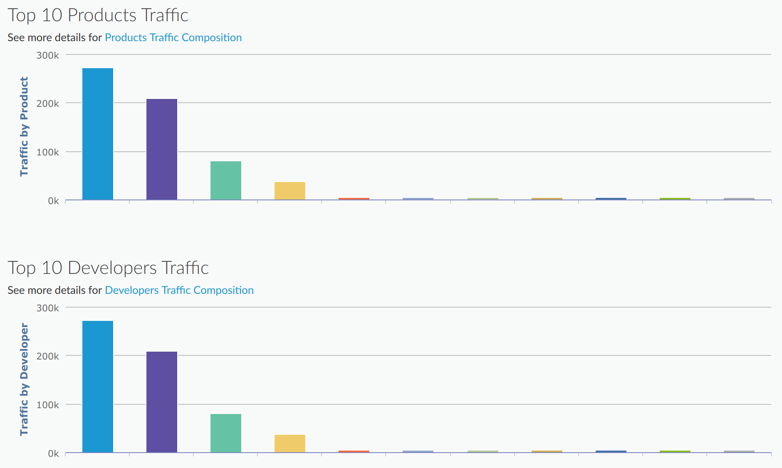
Traffic Composition

Slide 9
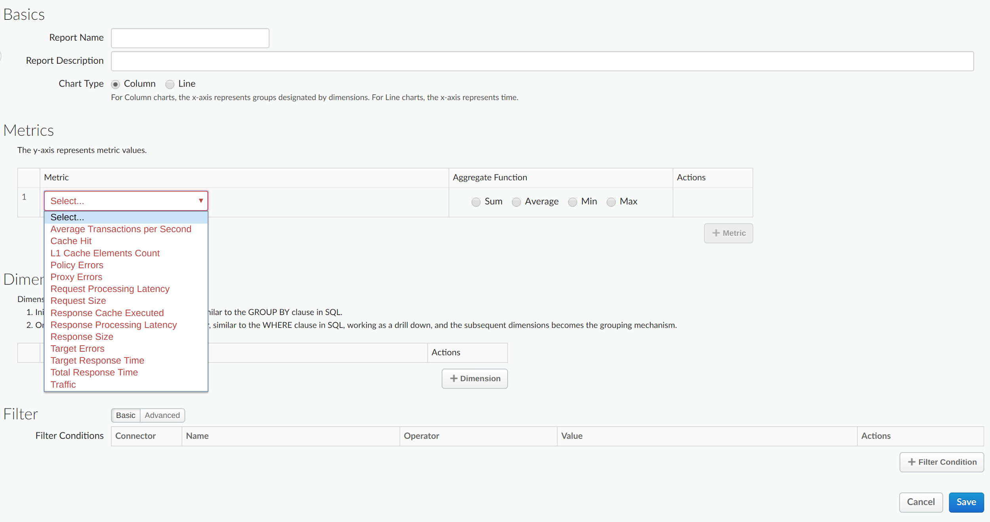
Custom Reports
A custom report is a way to specify precisely what you want to measure across your API program. For instance, you can measure all API traffic generated from a specific client IP address.
Custom reports provide both chart and table views
NOTE: After API calls are made to proxies, it takes about 12 minutes for the data to appear in dashboards, custom reports, and management API calls.

Slide 10
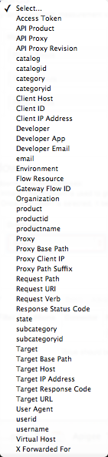
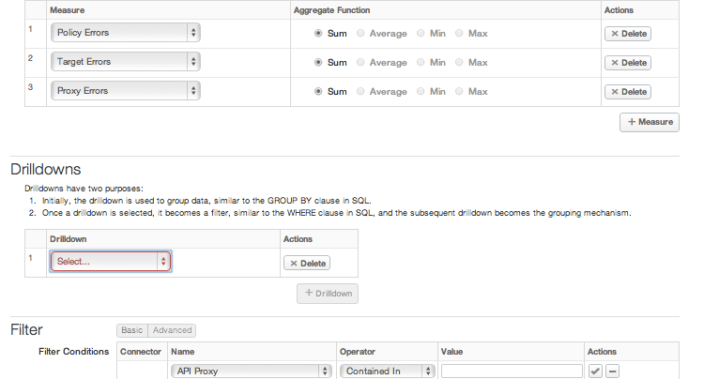
Custom Reports

Slide 11
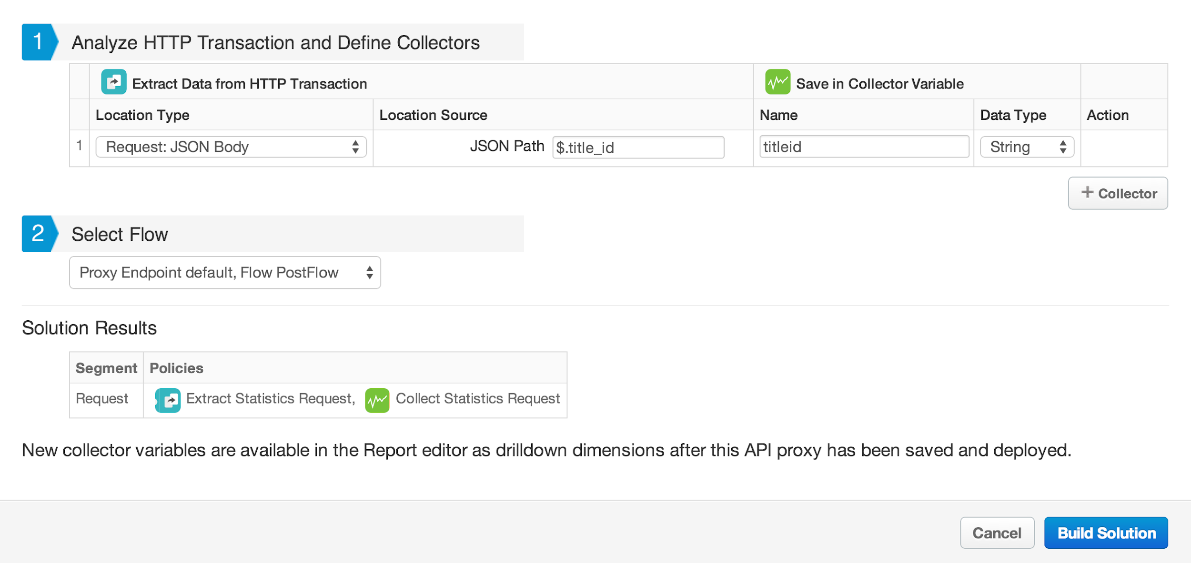
Custom Statistics Collector Policy
Edge allows developers to send any custom data in its out-of-box Analytics engine. This is available through a policy, and even a wizard to set up for you.

Slide 12
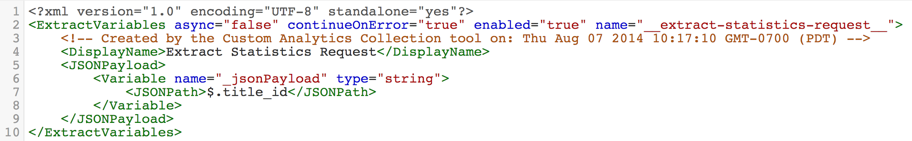
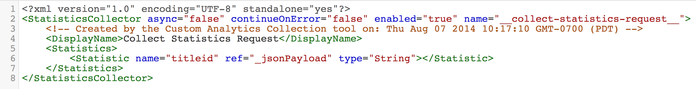
Custom Statistics Collector Policy
policies are auto-generated by the wizard
can be manually customized to extract any part of the HTTP message for used in the StatisticsCollector policy

Slide 13
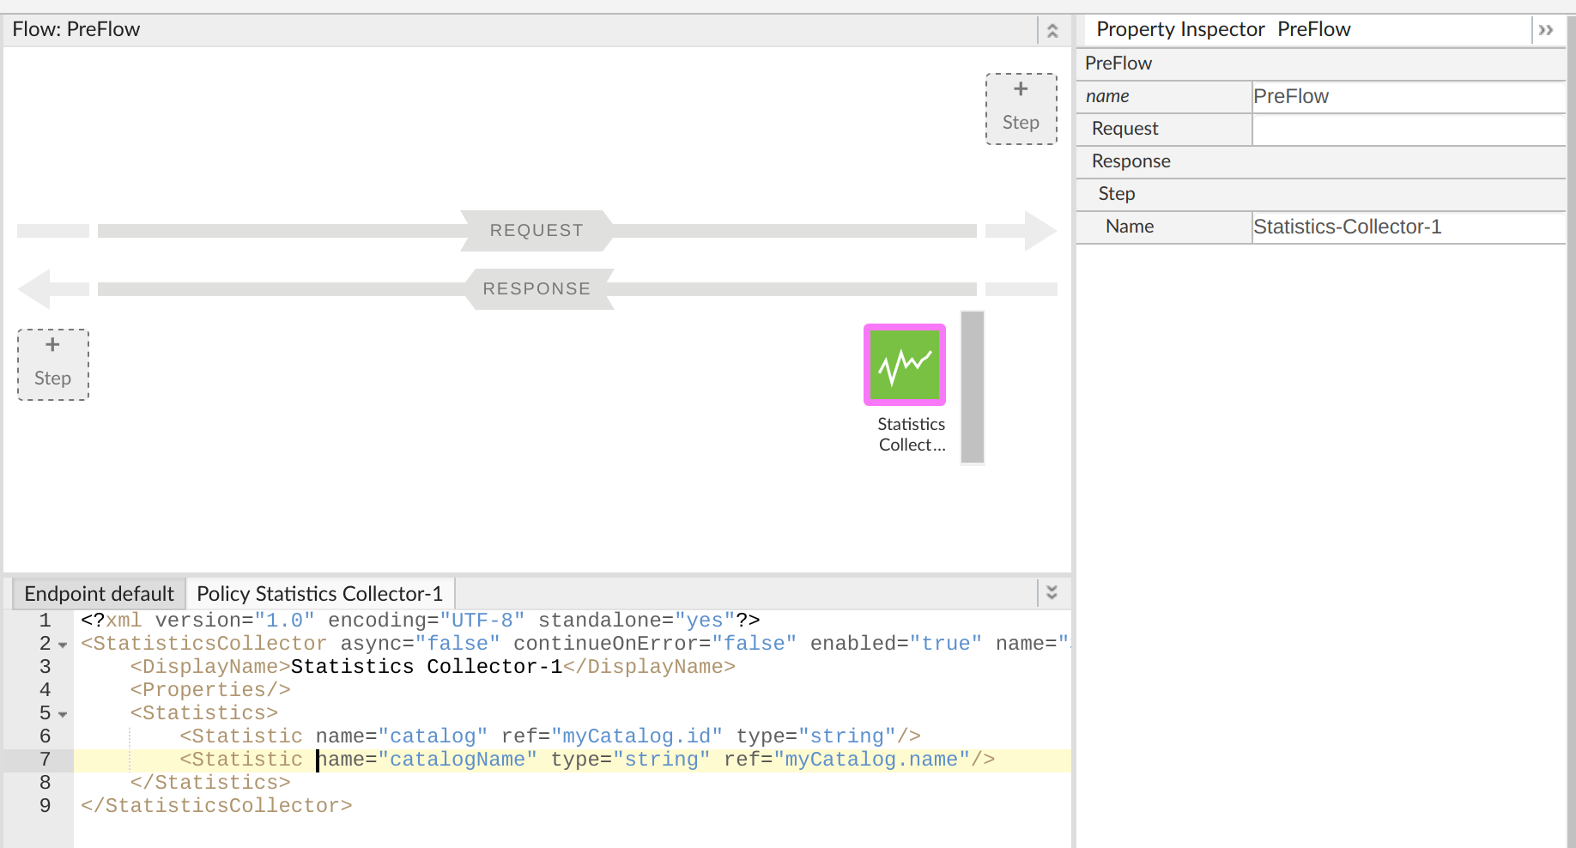
Custom Analytics Data
add custom analytics data during API execution, then report on it using custom reports
custom analytics data can come from any portion of the inbound request or outbound response

Slide 14
Analytics API
Edge Analytics Services exposes a RESTful API.
Can be used to automate certain Analytics functions, such as retrieving metrics periodically using an automation client or script.
Can also be used to build your own visualizations in the form of custom widgets that you can embed in portals or custom apps.
The base URL that you invoke to retrieve statistics for dimensions is the following:
https://api.enterprise.apigee.com/v1/o/{org_name}/e/{env_name}/stats
The following dimensions are supported :
/apis
/apiproducts
/apps
/devs
For more info on the API, refer the following links:
https://docs.apigee.com/api/stats
https://docs.apigee.com/management/apis/get/organizations/%7Borg_name%7D/stats
https://docs.apigee.com/analytics-services/reference/analytics-command-reference

Slide 15
THANK YOU

